Slide 1
Object as a Universal Super Class and Wrapper Classes

Slide 2
Object class
Object is a universal superclass in java
The Object class is the parent class of all the classes in java by default. In other words, it is the topmost class of java.
The Object class is beneficial if you want to refer any object whose type you don't know.
Notice that parent class reference variable can refer the child class object, known as upcasting.

Slide 3
Object class
E.g., there is getObject() method that returns an object but it can be of any type like Employee, Student etc, we can use Object class reference to refer that object. For example:
Object obj = getObject();
we don't know what object would be returned from this method
The Object class provides some common behaviors to all the objects such as object can be compared, object can be cloned, object can be notified etc.

Slide 4
Con’t
Of course, a variable of type Object is only useful as a generic holder for arbitrary values.
If you have some knowledge about the original type and then apply a cast:
Employee e = (Employee) obj;
Only primitive types (numbers, characters, and Boolean values) are not objects.
All array types no matter whether they are arrays of objects or arrays of primitive types, are class types that extent the object class.

Slide 5
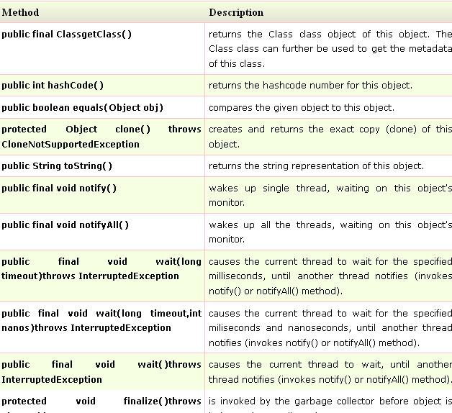

Slide 6
java.lang.Object
The Java super class java.lang.Object has two very important methods defined in it. They are -
public boolean equals(Object obj)
public int hashCode()
The equals() method checks if some other object passed to it as an argument is equal to the object on which this method is invoked.
The default implementation of this method in Object class simply checks if two object references x and y refer to the same object.
i.e. It checks if x == y.

Slide 7
public Boolean equals(Object obj)
Object class has no data members that define its state, So, it simply performs shallow comparison.
However, the classes providing their own implementations of the equals method are supposed to perform a "deep comparison";
by actually comparing the relevant data members.
The equals method for class Object implements the most discriminating possible equivalence relation on objects;
that is, for any reference values x and y, this method returns true if and only if x and y refer to the same object.

Slide 8
What JDK 1.4 API documentation says about the equals method?
The equals method implements an equivalence relation: It is reflexive: for any reference value x, x.equals (x) should return true.
It is symmetric: for any reference values x and y, x.equals(y) should return true if and only if y.equals (x) returns true.
It is transitive: for any reference values x, y, and z, if x.equals(y) returns true and y.equals (z) returns true, then x.equals (z) should return true.
It is consistent: for any reference values x and y, multiple invocations of x.equals (y) consistently return true or consistently return false, provided no information used in equals comparisons on the object is modified.
For any non-null reference value x, x.equals (null) should return false.

Slide 9
public int hashCode()
This method returns the hash code value for the object on which this method is invoked.
It returns the hash code value as an integer and is supported for the benefit of hashing based collection classes such as Hashtable, HashMap, HashSet etc.
This method must be overridden in every class that overrides the equals method.

Slide 10
The general contract of hashCode
Whenever it is invoked on the same object more than once during an execution of a Java application, the hashCode method must consistently return the same integer, provided no information used in equals comparisons on the object is modified.
This integer need not remain consistent from one execution of an application to another execution of the same application.

Slide 11
The general contract of hashCode
If two objects are equal according to the equals(Object) method, then calling the hashCode method on each of the two objects must produce the same integer result.
It is not required that if two objects are unequal according to the equals(java.lang.Object) method, then calling the hashCode method on each of the two objects must produce distinct integer results.

Slide 12
The toString Method
Object's toString method returns a String representation of the object.
You can use toString to display an object.
For example, you could display a String representation of the current Thread like this:
System.out.println(Thread.currentThread().toString());
The String representation for an object is entirely dependent on the object.
The String representation of an Integer object is the integer value displayed as text.
The toString method is very useful for debugging and you should override this method in all your classes.

Slide 13
Con’t
The toString method of the Point class returns a string:
java.awt.Point[x=10,y=20]
Class Employee {
public String toString() {
return getClass().getName() + "[name=" + name + ",salary=" + salary + ",hireDay=" + hireDay + “]”;
}
}
class Manager extends Employee {
public String toString() {
return super.toString() + "[bonus=" + bonus + "]";
}
}
Output: Manager object will be printed as
Manager[name=...,salary=...,hireDay=...][bonus=...]

Slide 14
Con’t
Whenever an object is concatenated with a string by the "+" operator, the Java compiler automatically invokes the toString method to obtain a string representation of the object.
Example:
Point p = new Point(10, 20);
String message = "The current position is " + p;
// automatically invokes p.toString()
x.toString(), you can write "" + x
x can be of primitive type.
If x is any object and you call
System.out.println(x);
calls x.toString() and prints the resulting string.

Slide 15
Wrapper Classes
Wrapper class in java provides the mechanism to convert primitive into object and object into primitive.
Since J2SE 5.0, autoboxing and unboxing feature converts primitive into object and object into primitive automatically.
The automatic conversion of primitive into object is known as autoboxing and vice-versa unboxing.

Slide 16
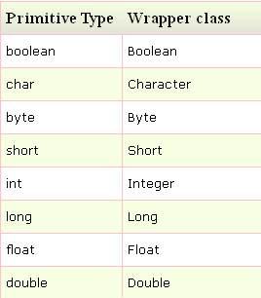
Wrapper Classes
The list of eight wrapper classes are given below:

Slide 17
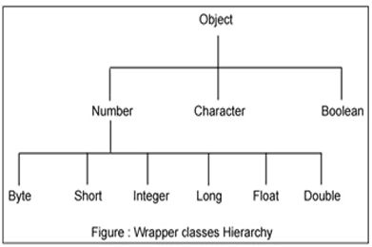
Wrapper class hierarchy

Slide 18
Wrapper class Example: Primitive to Wrapper
public class WrapperExample1{
public static void main(String args[]){
//Converting int into Integer
int a=20;
Integer i=Integer.valueOf (a); //converting int into Integer
//autoboxing, now compiler will write Integer.valueOf (a) internally
Integer j=a;
System.out.println (a+" "+i+" "+j);
}
}

Slide 19
Wrapper class Example: Wrapper to Primitive
public class WrapperExample2{
public static void main(String args[]){
//Converting Integer to int
Integer a=new Integer(3);
int i=a.intValue();//converting Integer to int
//unboxing, now compiler will write a.intValue() internally
int j=a;
System.out.println(a+" "+i+" "+j);
}
}

